Slide 1
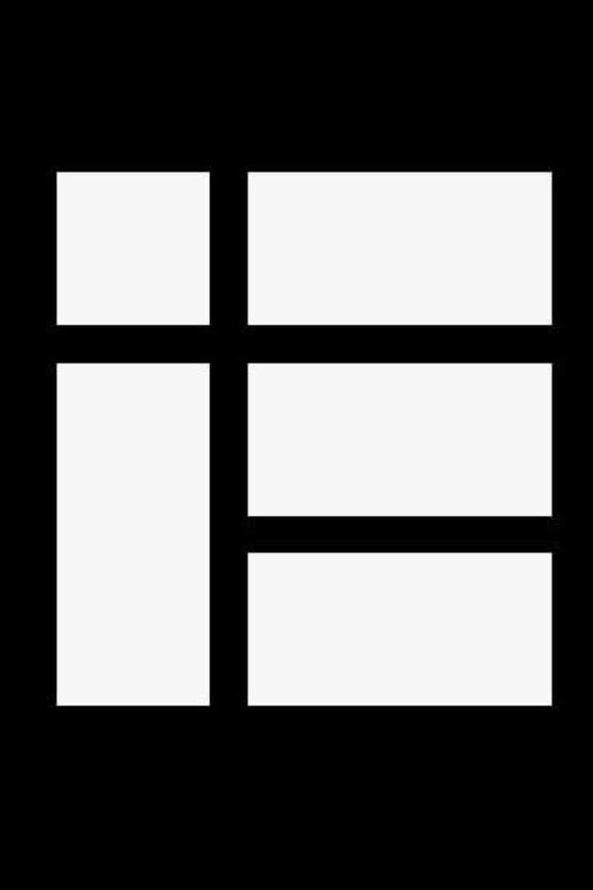

Kotlin Idioms #1
A collection of random and frequently used idioms in Kotlin. If you have a favorite idiom, contribute it by sending a pull request.

Slide 2

Default Values Function Parameters﻿
fun foo(a: Int = 0, b: String = "") { ... }

Slide 3
Filter a List﻿
val positives = list.filter { x -> x > 0 }
Or alternatively, even shorter:
val positives = list.filter { it > 0 }

Slide 4
Check the Element in a Collection﻿
if ("john@example.com" in emailsList) { ... }
if ("jane@example.com" !in emailsList) { ... }

Slide 5
Instance Checks﻿
when (x) {
is Foo -> ...
is Bar -> ...
else -> ...
}

Slide 6
Read-only list﻿
val list = listOf("a", "b", "c")
Read-only map﻿
val map = mapOf("a" to 1, "b" to 2, "c" to 3)

Slide 7
Access a map entry﻿
println(map["key"])
map["key"] = value
Traverse a Map or a List of Pairs﻿
for ((k, v) in map) {
println("$k -> $v")
}
k and v can be any convenient names, such as name and age.

Slide 8
Iterate Over a Range﻿
for (i in 1..100) { ... } // closed-ended range: includes 100
for (i in 1..<100) { ... } // open-ended range: does not include 100
for (x in 2..10 step 2) { ... }
for (x in 10 downTo 1) { ... }
(1..10).forEach { ... }
Lazy Property﻿
val p: String by lazy { // the value is computed only on first access
// compute the string
}

Slide 9
Extension functions﻿
fun String.spaceToCamelCase() { ... }
"Convert this to camelcase".spaceToCamelCase()
Create a Singleton﻿
object Resource {
val name = "Name"
}

Slide 10

Instantiate an Abstract Class﻿
abstract class MyAbstractClass {
abstract fun doSomething()
abstract fun sleep()
}
fun main() {
val myObject = object : MyAbstractClass() {
override fun doSomething() {
// ...
}
override fun sleep() { // ...
}
}
myObject.doSomething()
}

